Slide 1
Network Matrices

Slide 2
Network Matrices
The mathematical model of the networks can be developed in three different forms and these are
1. Bus frame of reference
2.Branch frame of reference
3.Loop frame of reference

Slide 3
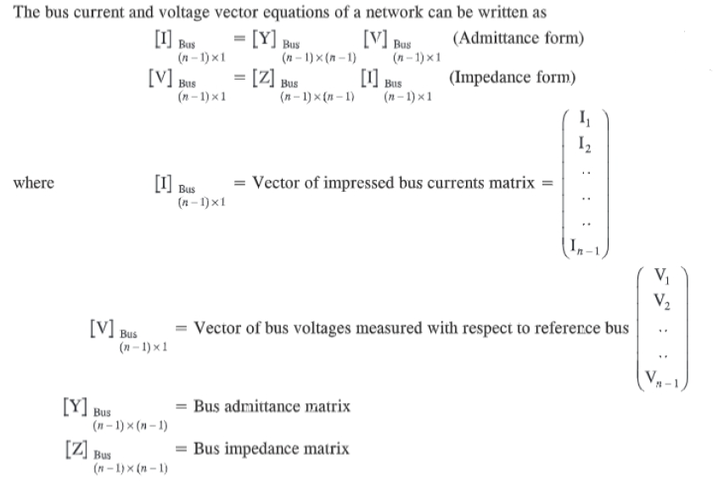
1. Bus frame of reference

Slide 4
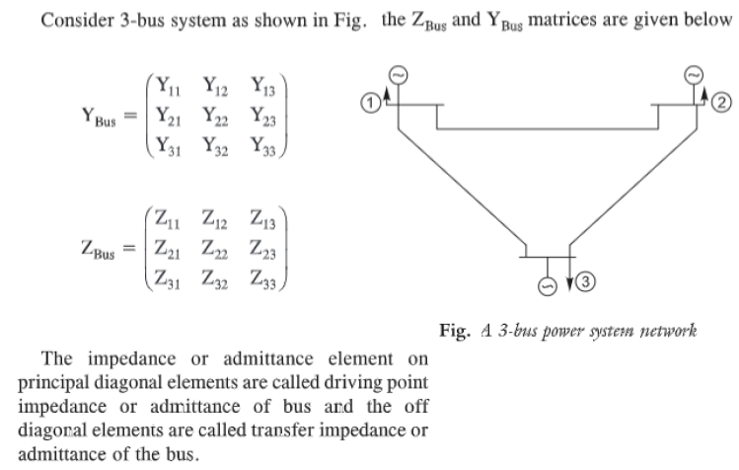

Slide 5
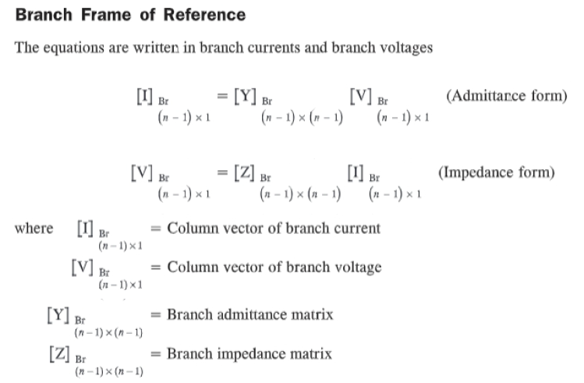

Slide 6
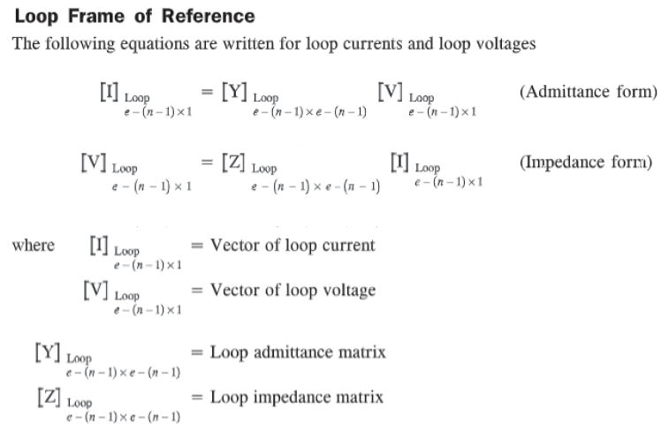

Slide 7
Construction of primitive network element
Primitive network is a set of unconnected elements represented either impedance form or admittance form
There are two types of representation for primitive networks and they are
1.Impedence form
2.Admitance form

Slide 8
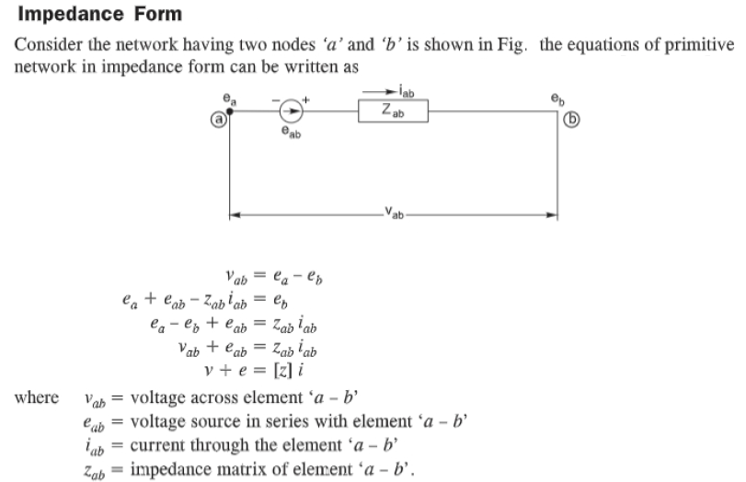

Slide 9
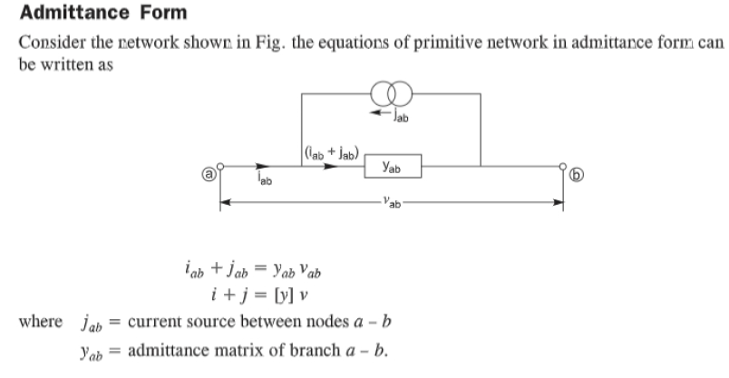

Slide 10
NETWORK MATRIX FORMATION
The admittance matrix Y and impedance matrix Z can be determined by using the following methods:
1.Based on the incidence matrices
a)Singular transformation method
b)Non singular transformation method
2.Based on the network analysis equation
By direct inspection method

Slide 11
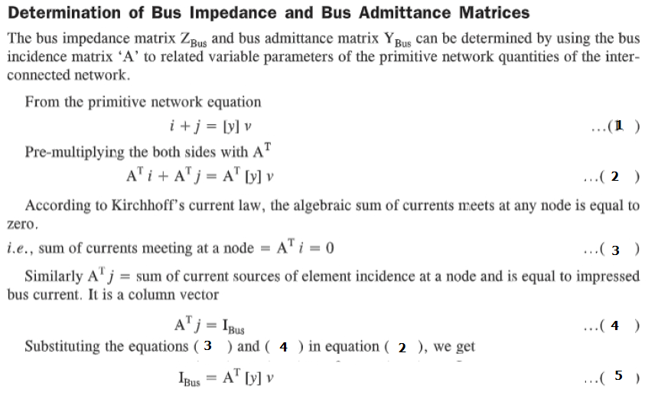

Slide 12
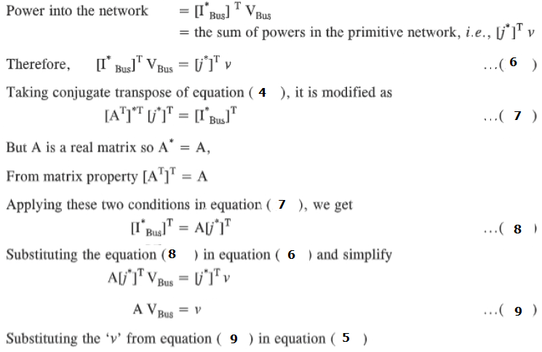

Slide 13
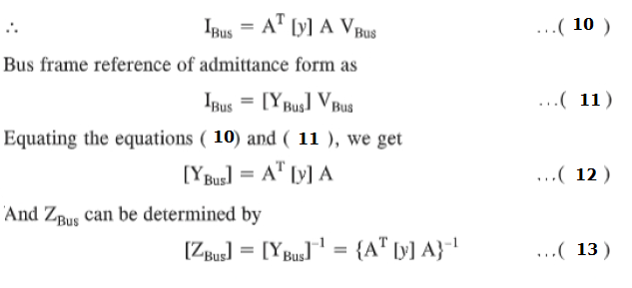

Slide 14
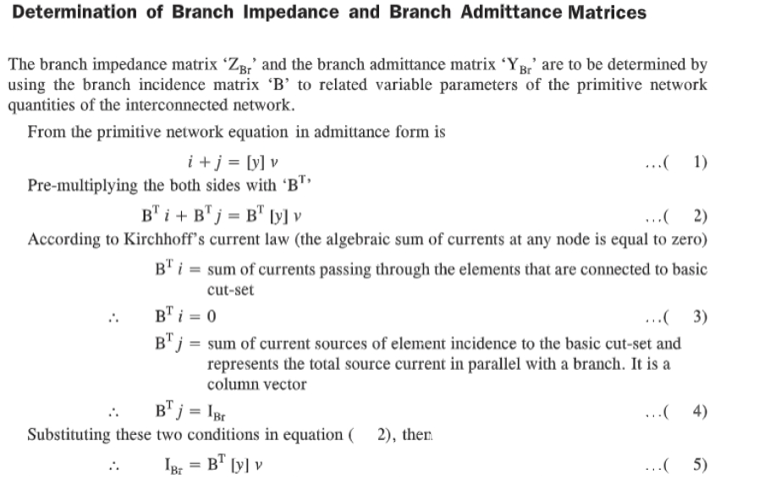

Slide 15
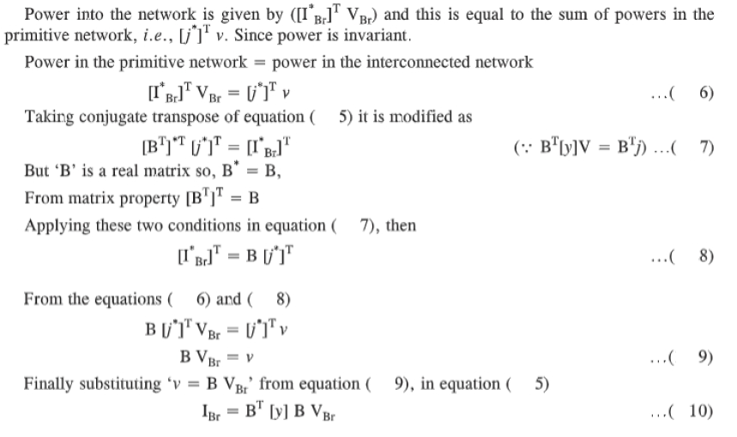

Slide 16
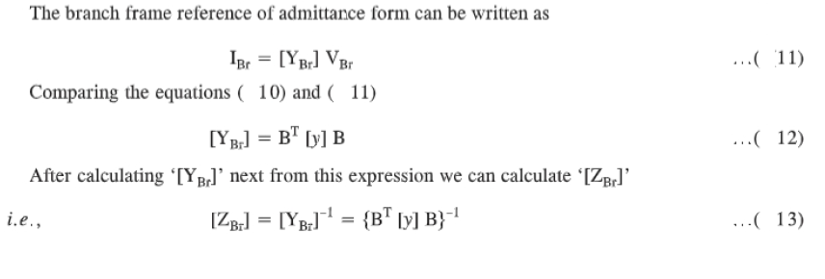

Slide 17
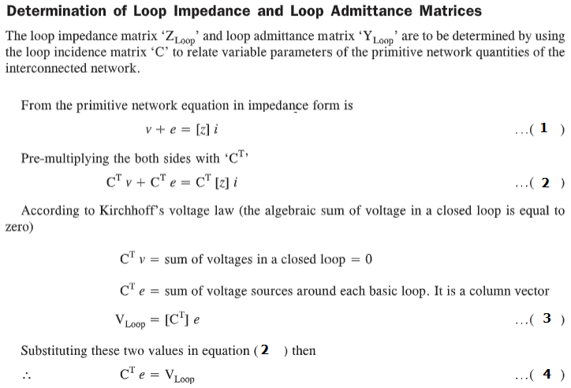

Slide 18
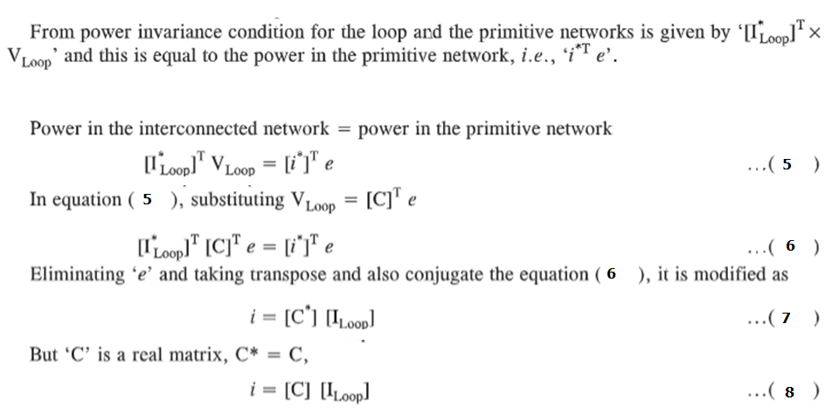

Slide 19
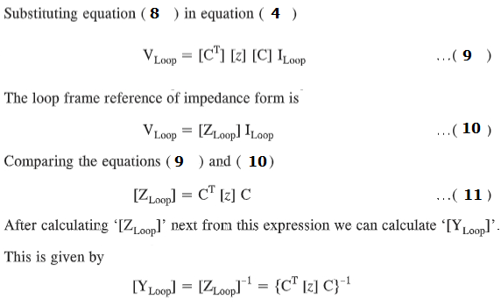

Slide 20
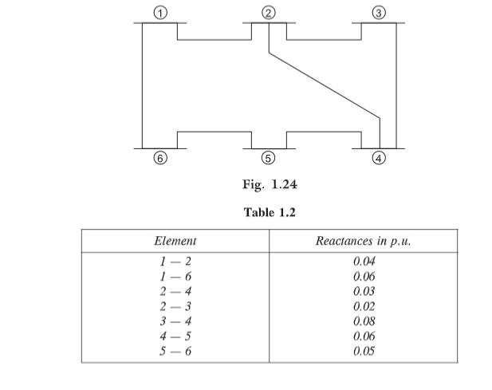

Slide 21
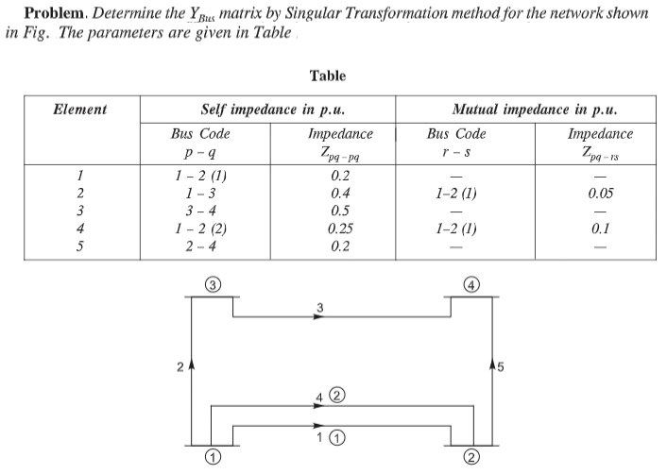

Slide 22


Slide 23



Slide 24



Slide 25

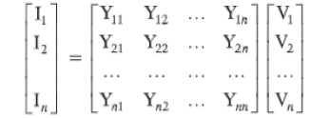

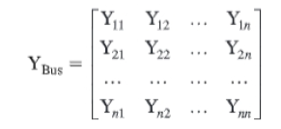

Slide 26
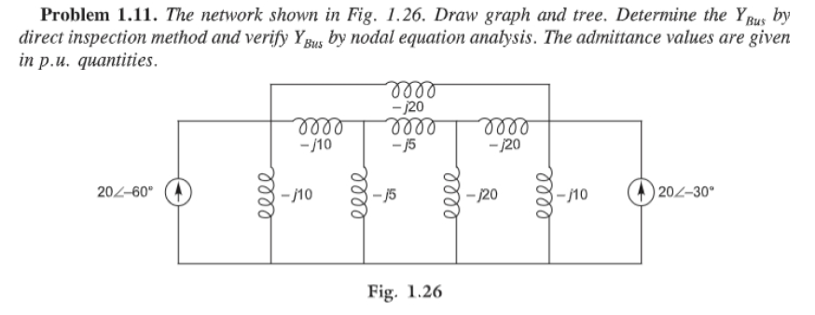
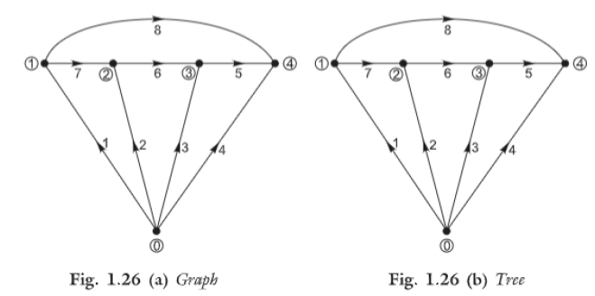

Slide 27
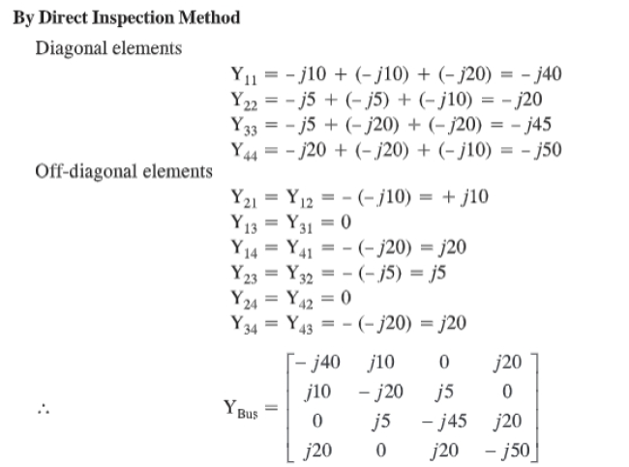

Slide 28
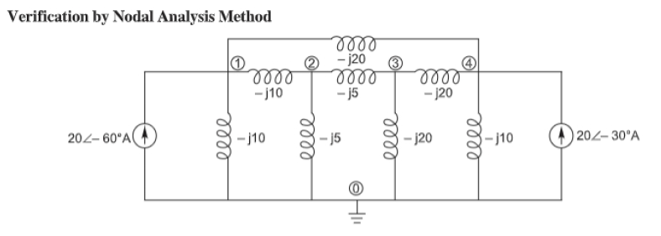

Slide 29
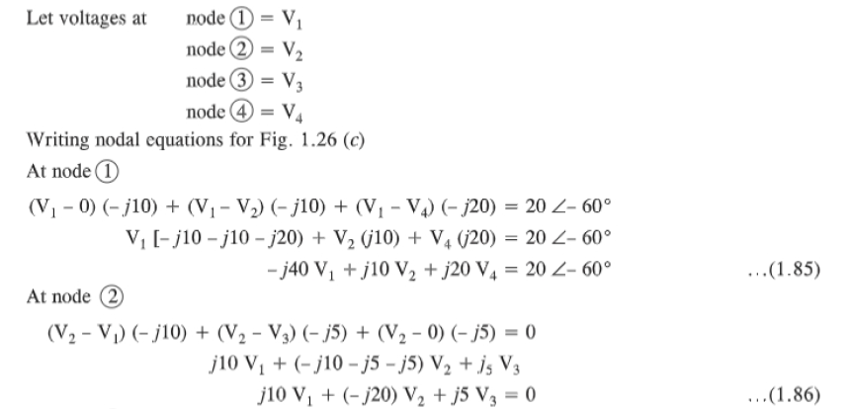

Slide 30
